Slide 1
EMI Noise Impedance
Quick Overview
Abel Keeley
Electronics EEDP | Clothes Care
GE Appliances, a Haier company

Slide 2
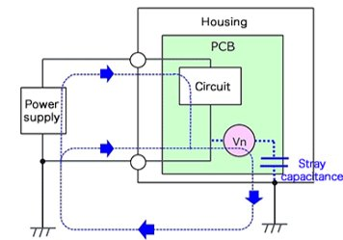
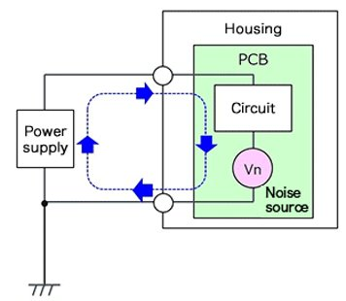
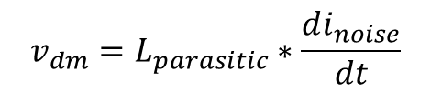
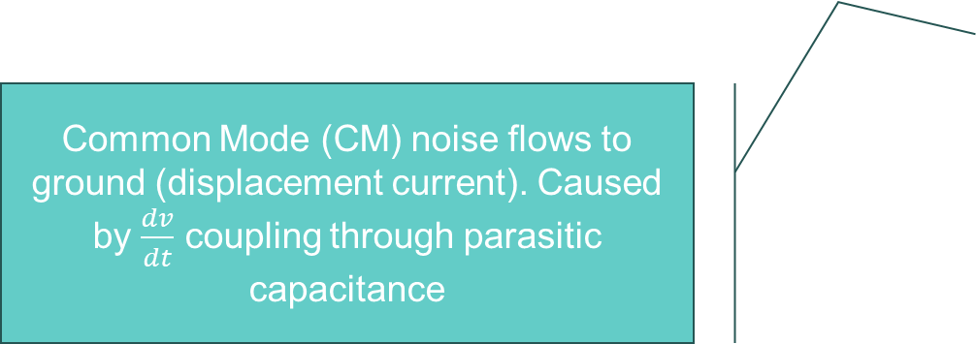
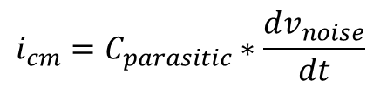
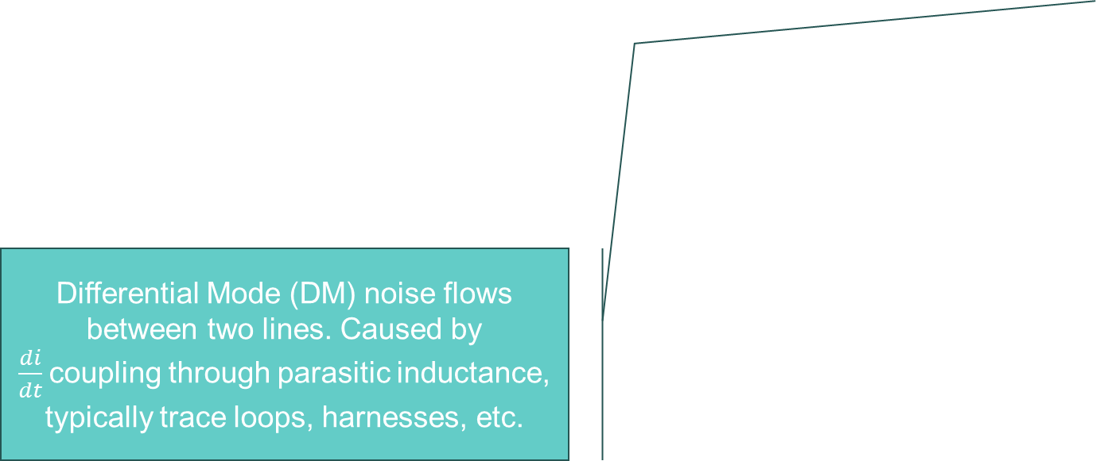
Background - Theoretical
Disturbance in electrical circuit due to outside source[s] of electromagnetic energy.
EMI
CM
DM
Common Mode (CM) noise flows to ground (displacement current). Caused by $\frac{dv}{dt}$ coupling through parasitic capacitance
Differential Mode (DM) noise flows between two lines. Caused by $\frac{di}{dt}$coupling through parasitic inductance, typically trace loops, harnesses, etc.
$$i_{cm}=C_{parasitic}∗\frac{dv_{noise}}{dt}$$
$$v_{dm}=L_{parasitic}∗\frac{di_{noise}}{dt}$$
Notes:
Source: Advanced EMI, B1 class slides @ Global Edison Program - Lecture Material - All Documents (sharepoint.com)

Slide 3
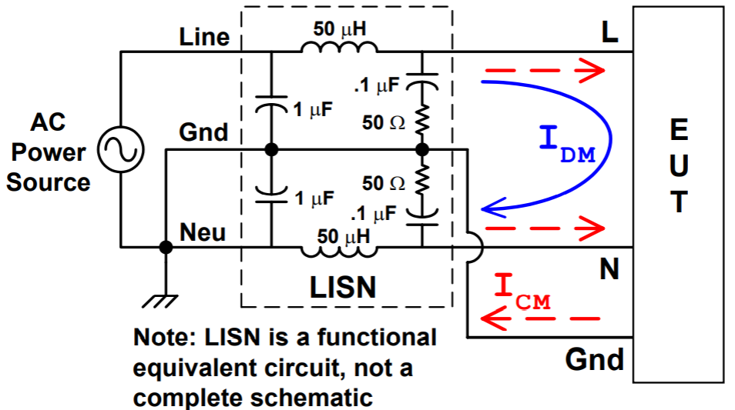
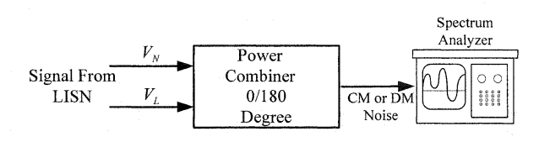
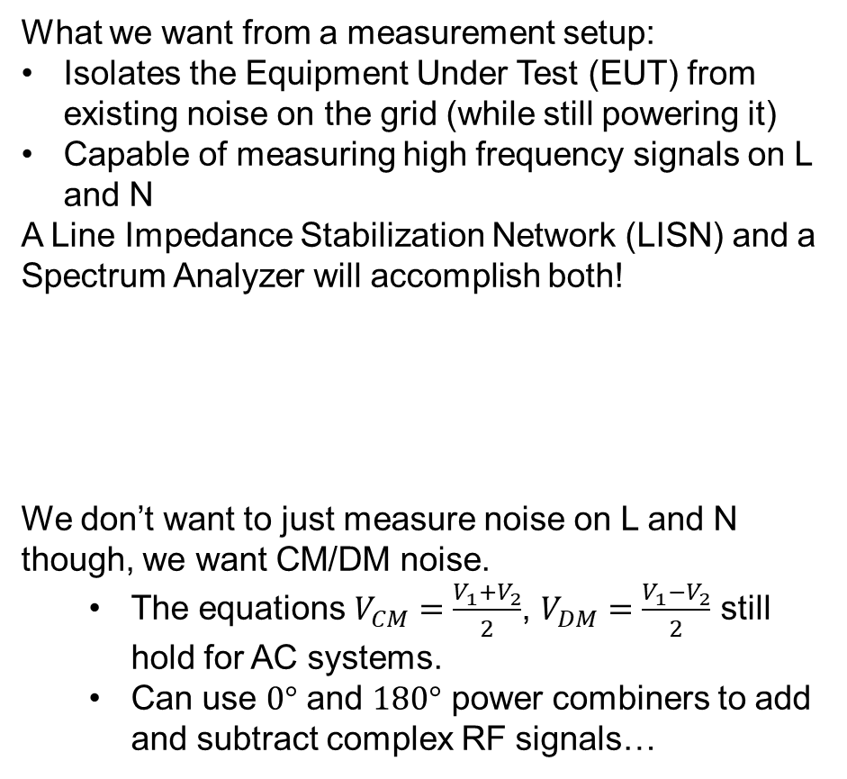
Background - Measurements
What we want from a measurement setup:
Isolates the Equipment Under Test (EUT) from existing noise on the grid (while still powering it)
Capable of measuring high frequency signals on L and N
A Line Impedance Stabilization Network (LISN) and a Spectrum Analyzer will accomplish both!
We don’t want to just measure noise on L and N though, we want CM/DM noise.
The equations $V_{CM}=\frac{V_{1}+V_{2}}{2}$, $V_{DM}=\frac{V_{1}−V_{2}}{2}$ still hold for AC systems.
Can use $0°$ and $180°$ power combiners to add and subtract complex RF signals…
Notes:
Sources: “EMI: Theory, Issues, and Solutions” -> EMITrainingSlides.pdf @ Electronics Hardware Portal - Historic Presentations - All Documents (sharepoint.com), “New EMI Filter Design Methods for DC-DC and AC-DC Switching Power Supplies”.

Slide 4
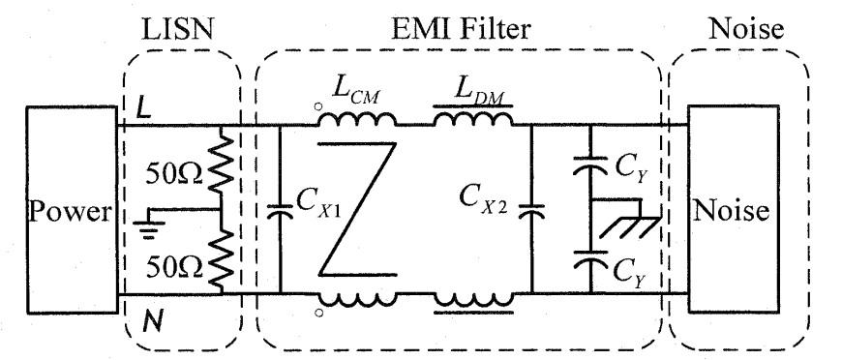
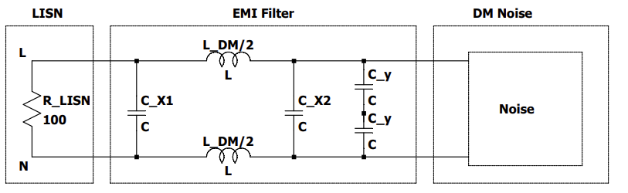
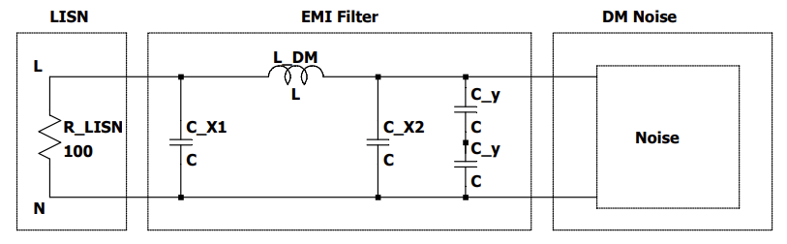
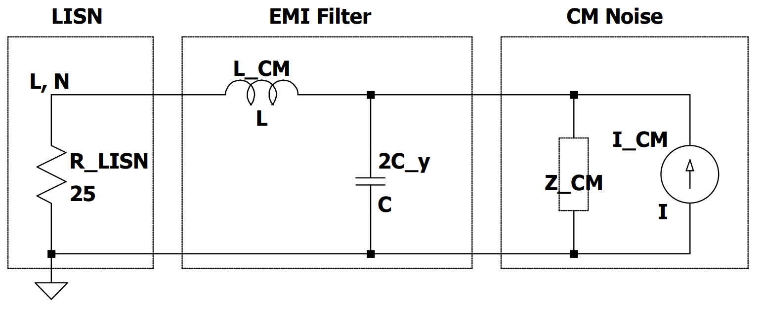
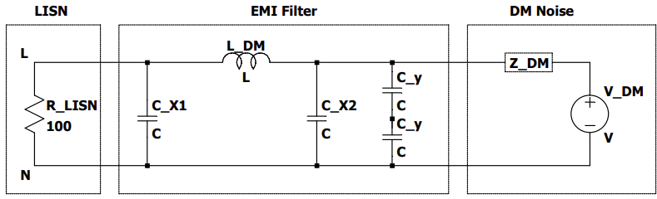
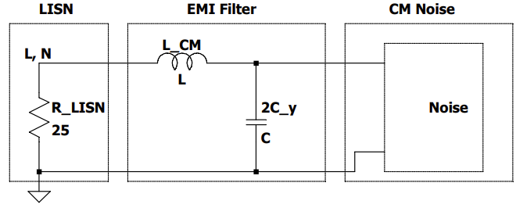
Background – Circuit Analysis
This circuit representation, while correct, is not particularly helpful for considering EMI performance.
CM Eqv. Circuit
DM Eqv. Circuit

Slide 5
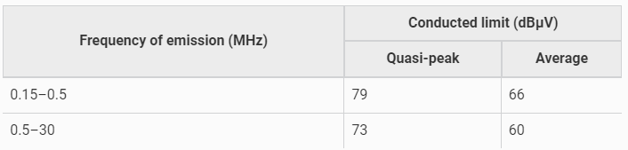
Motivation
FCC Conducted Emissions Limits
Want our appliances to meet FCC Part A conducted emission limits.
Not a legal requirement, as most digital appliances are exempt from these limits.
To try and meet these requirements, some form of filter is often required.
Due to the complexity of EMI filter design, older designs are often recycled with minor tweaks
This strategy generally entails much iteration, guided by significant amounts of manual testing.
A design methodology that would reduce the number of iterations would help drive better designs
Conducted Emissions Results for Current Production PTW600
Notes:
Sources: FCC Title 47, Chapter I, Subchapter A, Part 15 -> eCFR :: 47 CFR Part 15 -- Radio Frequency Devices

Slide 6
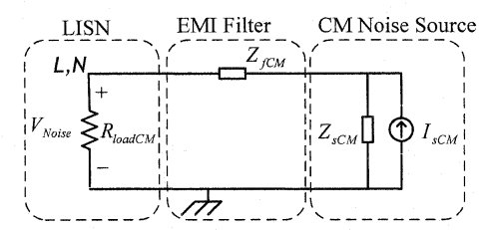
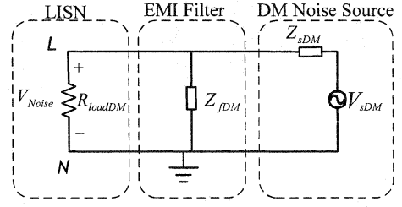


EMI Filter – General Strategy
Ideally, prevent noise from coupling into system at source.
Reduce parasitic inductance, capacitance
Easier said than done
Failing that, use a filter at the device input to prevent as much noise from leaving the appliance as possible.
Filters for CM and DM noise can be (mostly) designed separately.
The noise source has an impedance and the LISN also has an impedance, EMI filter should mismatch impedances to attenuate the noise as much as possible.
So, need to have an idea as to the impedance of the noise source to effectively design an EMI filter.
Noise impedance is:
Non-ideal
Frequency dependent.
Electrical Circuit Dependent
Appliance Geometry Dependent
Notes:
Sources: FCC Title 47, Chapter I, Subchapter A, Part 15 -> eCFR :: 47 CFR Part 15 -- Radio Frequency Devices

Slide 7
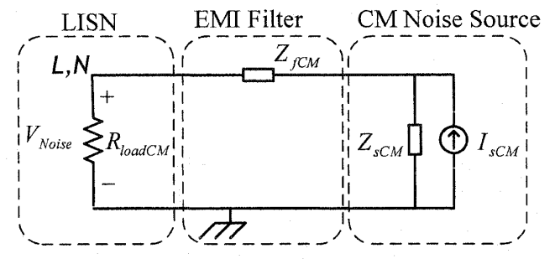

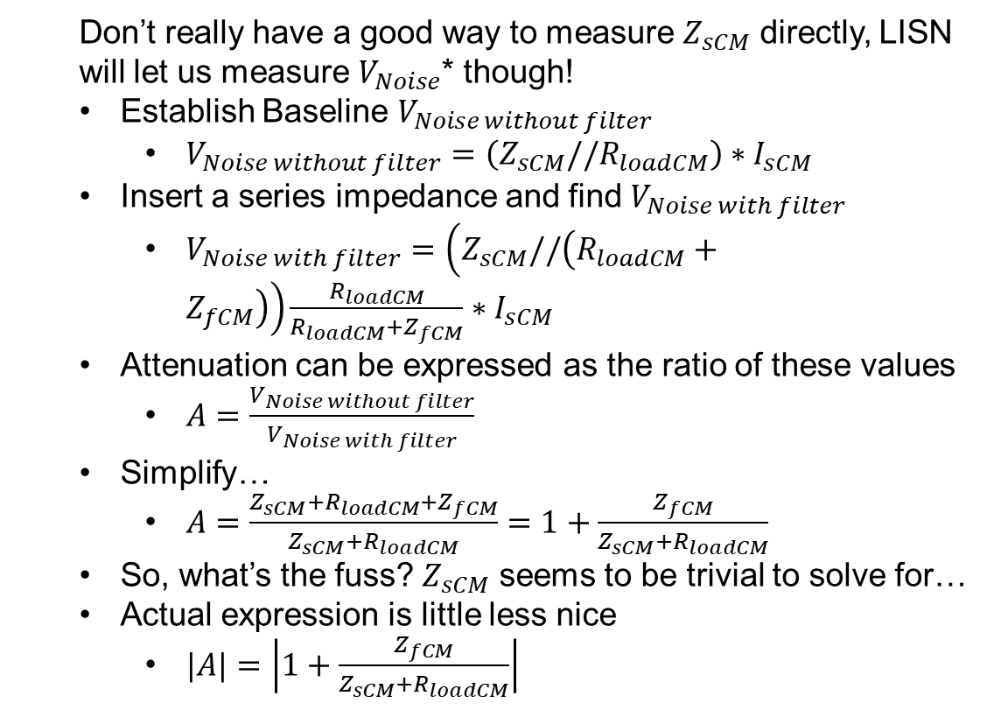
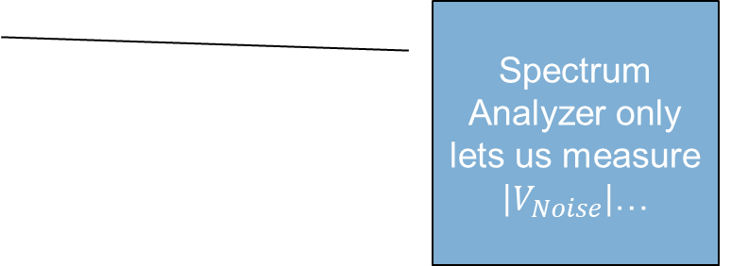






Determining Noise Source Impedance – Series Insertion
Baseline Measurement
Don’t really have a good way to measure $Z_{sCM}$ directly, LISN will let us measure $V_{Noise}$* though!
Establish Baseline $V_{Noise without filter}$
$V_{Noise without filter}=\left(Z_{sCM}//R_{loadCM}\right)∗I_{sCM}$
Insert a series impedance and find $V_{Noise with filter}$
$V_{Noise with filter}=\left(Z_{sCM}//\left(R_{loadCM}+Z_{fCM}\right)\right)\frac{R_{loadCM}}{R_{loadCM}+Z_{fCM}}∗I_{sCM}$
Attenuation can be expressed as the ratio of these values
$A=\frac{V_{Noise without filter}}{V_{Noise with filter}}$
Simplify…
$A=\frac{Z_{sCM}+R_{loadCM}+Z_{fCM}}{Z_{sCM}+R_{loadCM}}=1+\frac{Z_{fCM}}{Z_{sCM}+R_{loadCM}}$
So, what’s the fuss? $Z_{sCM}$ seems to be trivial to solve for…
Actual expression is little less nice
$|A|=\left|1+\frac{Z_{fCM}}{Z_{sCM}+R_{loadCM}}\right|$
Spectrum Analyzer only lets us measure $\left|V_{Noise}\right|$…
Purple: Vs
Orange: Voltage divider of Vnoise
Series Impedance Measurement

Slide 8
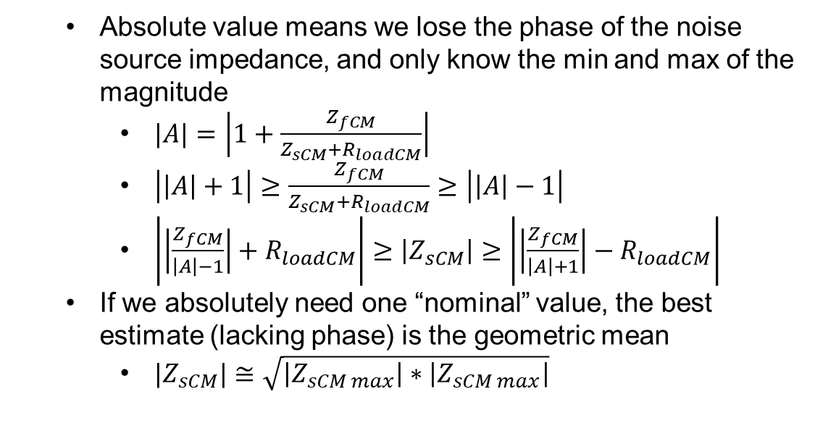
Determining Noise Source Impedance – Series Insertion
Baseline Measurement
Absolute value means we lose the phase of the noise source impedance, and only know the min and max of the magnitude
$|A|=\left|1+\frac{Z_{fCM}}{Z_{sCM}+R_{loadCM}}\right|$
$\left|\left|A\right|+1\right|≥\frac{Z_{fCM}}{Z_{sCM}+R_{loadCM}}≥\left|\left|A\right|−1\right|$
$\left|\left|\frac{Z_{fCM}}{\left|A\right|−1}\right|+R_{loadCM}\right|≥\left|Z_{sCM}\right|≥\left|\left|\frac{Z_{fCM}}{\left|A\right|+1}\right|−R_{loadCM}\right|$
If we absolutely need one “nominal” value, the best estimate (lacking phase) is the geometric mean
${|Z}_{sCM}|≅\sqrt{\left|Z_{sCM max}\right|∗\left|Z_{sCM max}\right|}$
Series Impedance Measurement

Slide 9

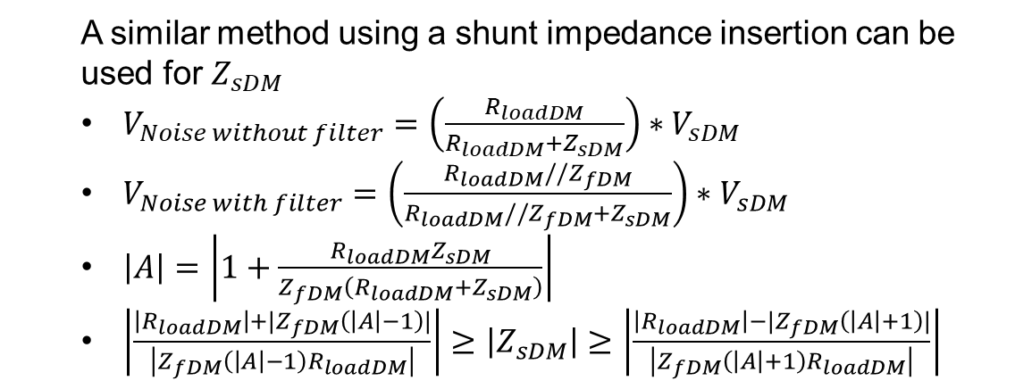


Determining Noise Source Impedance – Shunt Insertion
Baseline Measurement
A similar method using a shunt impedance insertion can be used for $Z_{sDM}$
$V_{Noise without filter}=\left(\frac{R_{loadDM}}{R_{loadDM}+Z_{sDM}}\right)∗V_{sDM}$
$V_{Noise with filter}=\left(\frac{R_{loadDM}//Z_{fDM}}{R_{loadDM}//Z_{fDM}+Z_{sDM}}\right)∗V_{sDM}$
$\left|A\right|=\left|1+\frac{R_{loadDM}Z_{sDM}}{Z_{fDM}\left(R_{loadDM}+Z_{sDM}\right)}\right|$
$\left|\frac{\left|R_{loadDM}\right|+|Z_{fDM}\left(\left|A\right|−1\right)|}{\left|Z_{fDM}\left(\left|A\right|−1\right)R_{loadDM}\right|}\right|≥\left|Z_{sDM}\right|≥\left|\frac{\left|R_{loadDM}\right|−|Z_{fDM}\left(\left|A\right|+1\right)|}{\left|Z_{fDM}\left(\left|A\right|+1\right)R_{loadDM}\right|}\right|$
Shunt Impedance Measurement

Slide 10




Determining Noise Source Impedance – Summary
Baseline Measurement
Knowing the noise source impedance allows us to calculate a nominal attenuation for our filters
Caveats
Only have a range for source impedance magnitude
Don’t know the source impedance phase
Source impedance is frequency dependent, likely won’t have good data spanning the entire frequency range
Assumptions will have to be made!
Calculated attenuation will only give rough idea of real world performance
Shunt Impedance Measurement

Slide 11
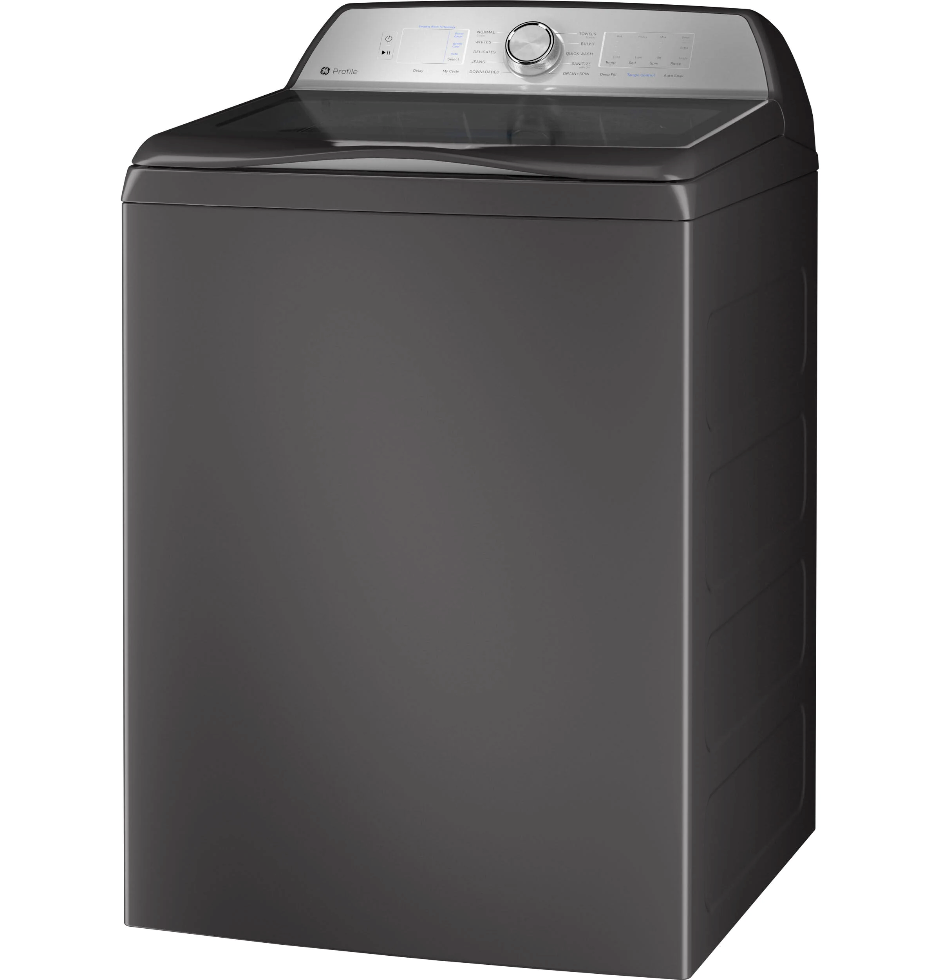
Example – PTW600

Slide 12
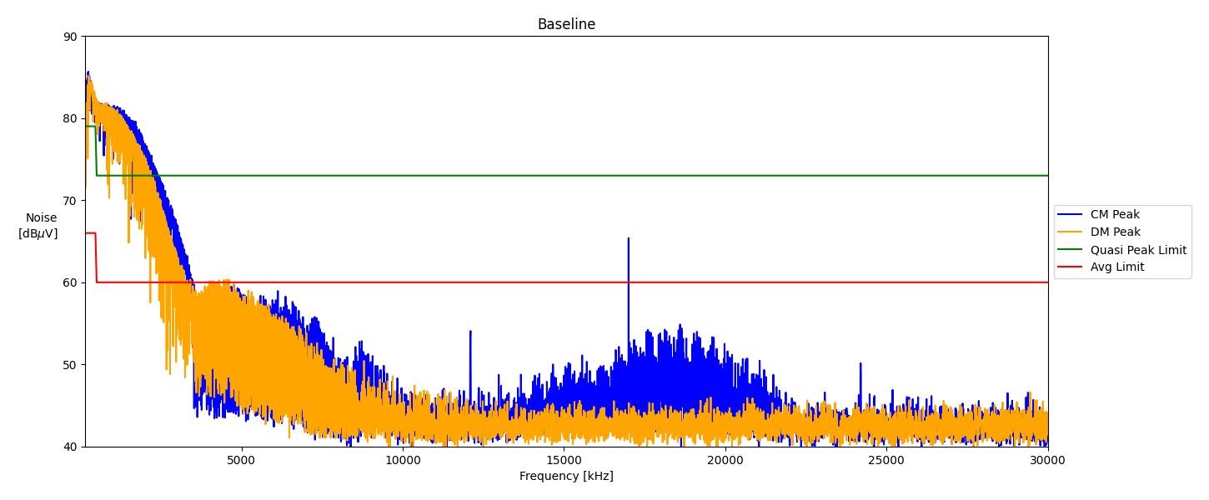
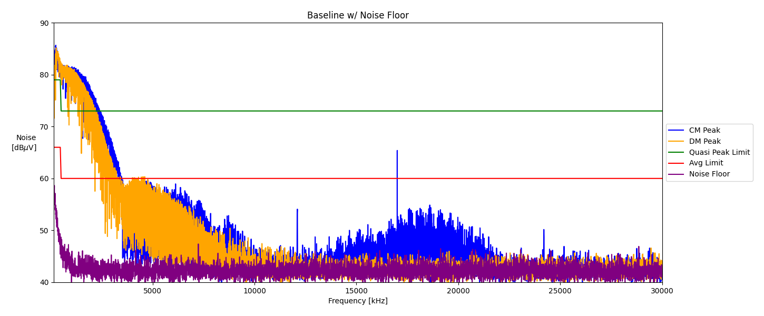
Baseline Measurements
Notes:
Remember to include noise floor… Talk about why peak measurements were taken? EMI specific measuring stuff?

Slide 13
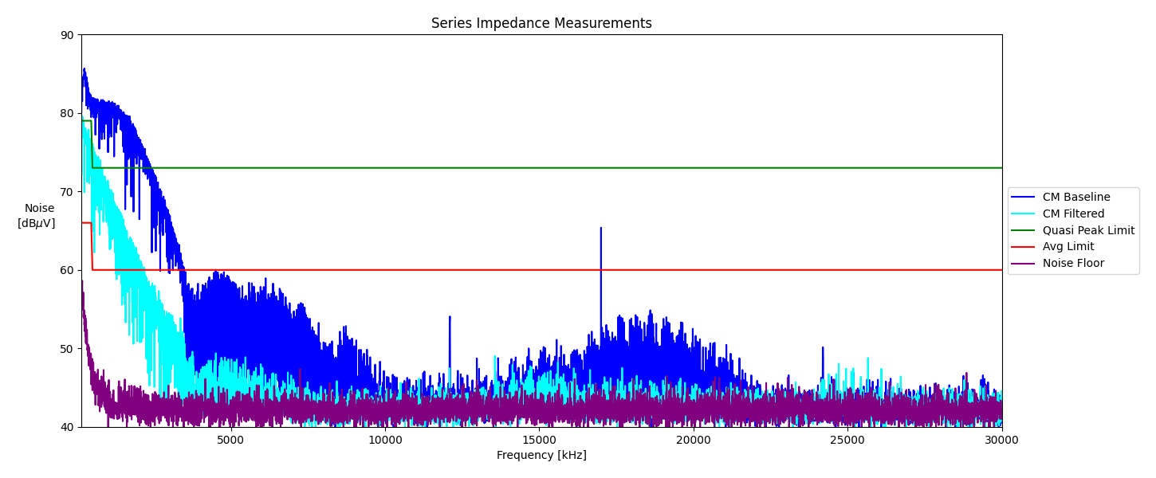
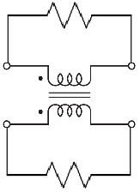
Series Measurement
Need to be above noise floor
Parallel resistors is a handy trick to degrade the performance of a choke.

Slide 14
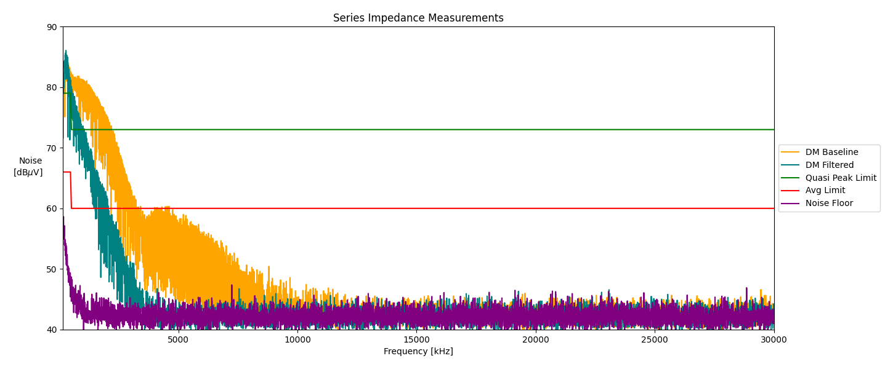
Shunt Measurement

Slide 15
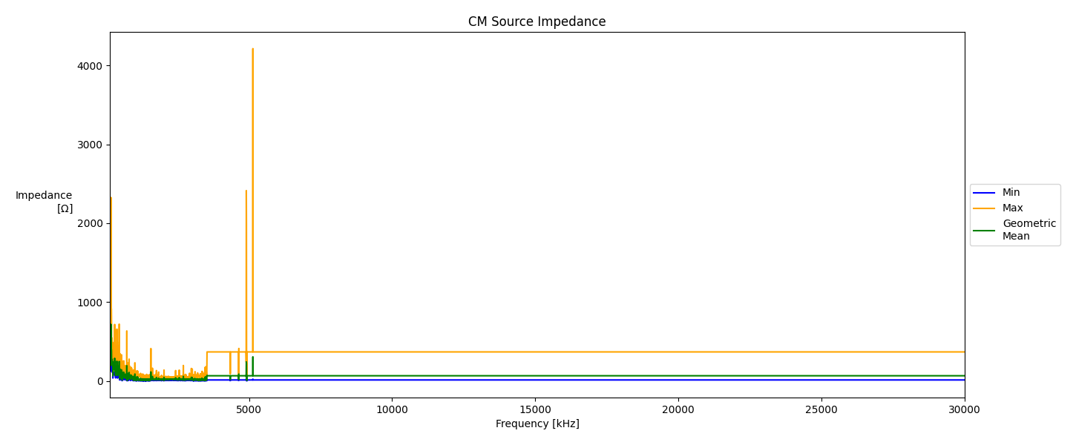
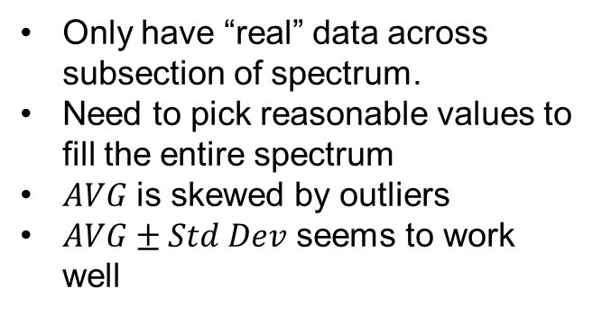
CM Source Impedance Calculation
Only have “real” data across subsection of spectrum.
Need to pick reasonable values to fill the entire spectrum
$AVG$ is skewed by outliers
$AVG±Std Dev$ seems to work well

Slide 16
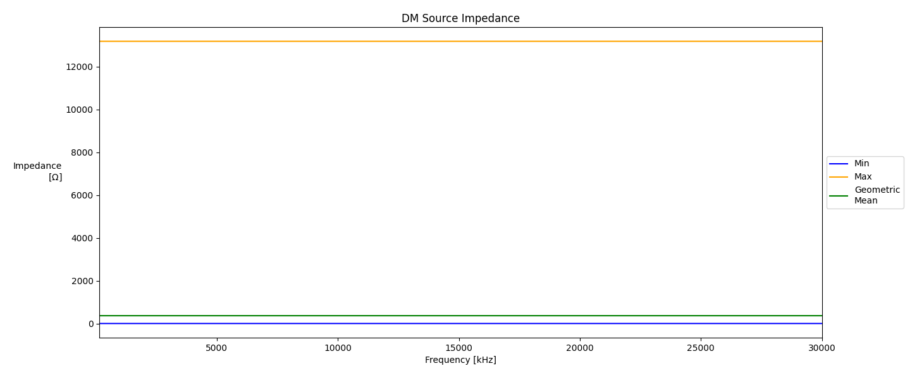
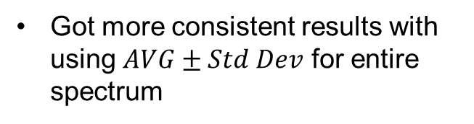
DM Source Impedance Calculation
Got more consistent results with using $AVG±Std Dev$ for entire spectrum

Slide 17
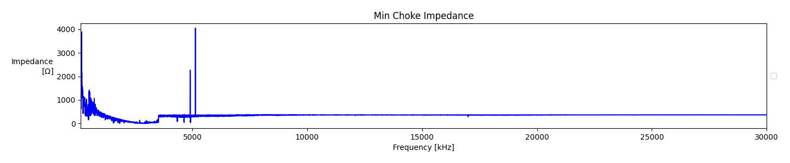
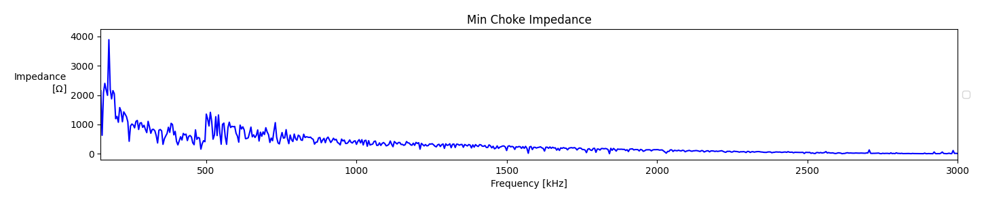
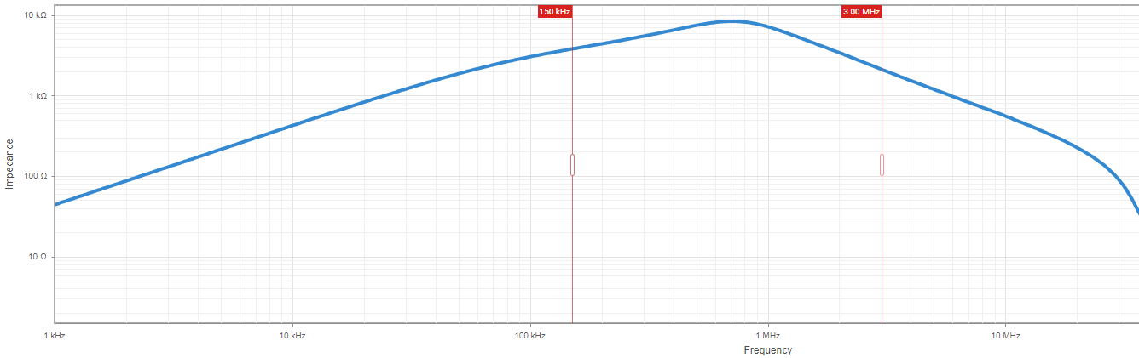
Choke Impedance Curve
Outliers here can probably be ignored
Lower Frequencies are of more interest for this chart
Sample Choke - Wurth
3.78k
2.12k

Slide 18
Current Production – No Choke
Peak
QP
Avg

Slide 19
Original Design – With Choke

Slide 20
New Design

Slide 21
Thank You
Abel Keeley
Electronics EEDP | Clothes Care
GE Appliances, a Haier company

Slide 22
Sources

Slide 23
Python Design Tool Walkthrough

Slide 24
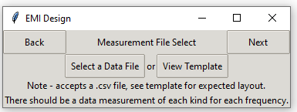
Measurement File Select
Example of what a measurement file should look like. Selecting view template will create a CSV file with the correct headers that you can copy your measurements into.
Frequency [Hz] | Common Mode Baseline Data [dBm] | Common Mode Filtered Data [dBm] | Noise Floor Data [dBm] | Differential Mode Baseline Data [dBm] | Differential Mode Filtered Data [dBm]
150000 | -26.98616 | -29.76937 | -50.23812 | -25.81429 | -24.72054
154500 | -24.69612 | -34.86702 | -49.47151 | -27.70394 | -25.84358
159000 | -24.84261 | -28.74886 | -50.02815 | -27.41585 | -25.29671
Note – the frequency should typically run from 150KHz to at least 30MHz. For every given frequency, there must be a measurement in every column.

Slide 25
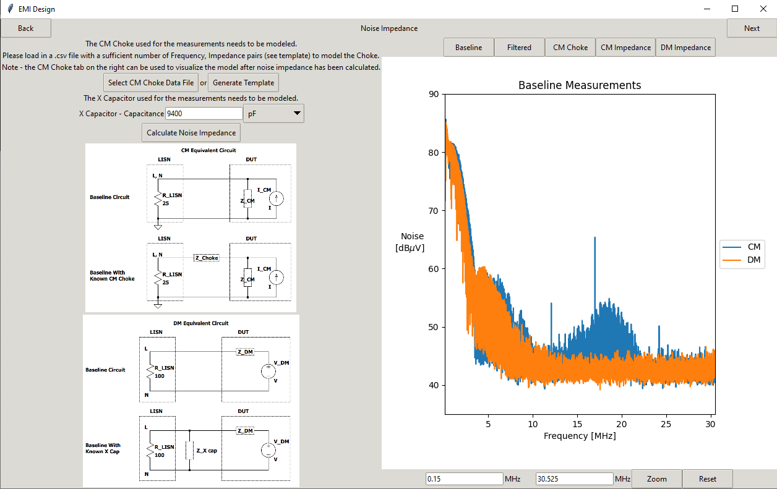
Noise Impedance
Check the data visualizations here to make sure they make sense. For finding source impedance, any measurements near the noise floor will be thrown out!
Example of what choke model file should look like. The tool will perform linear interpolation between the provided data points, so make sure you have enough data points to provide a reasonable accurate interpolation. Selecting Generate Template will create a CSV file with appropriate headers for you to fill out.
Frequency | Impedance
150000 | 636.2688
154500 | 620.0379
159000 | 604.7257
163500 | 590.2564
168000 | 576.5623
Note – the choke and capacitance numbers should reflect the actual components you used to gather the initial data with. You NEED TO TEST THOSE EXACT COMPONENTS.

Slide 26
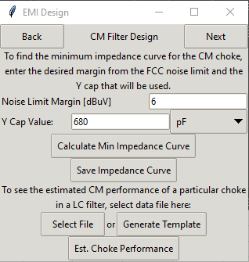
CM Filter Design
Pretty self explanatory. Enter what margin you want from the filter, and what Y cap will be used. The Min Impedance Curve will show an estimate of the minimum impedance needed from CM choke to pass conducted emissions with the desired margin.
The min impedance curve can be saved to CSV for future use. Really want to focus on frequency ranges where the appliance performs worst, as those are ranges where we both have the best data and have the most room for improvement.
Note – This tool assumes the CM filter will be an LC filter. Maybe this will be changed down the road?
The estimated performance of a given choke can be seen.

Slide 27
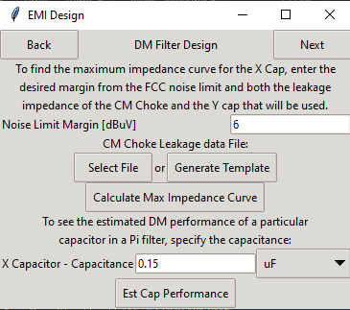
DM Filter Design
Similar to CM Design, but this time we are specifying CM choke leakage, and finding a maximum impedance curve for the X cap.
Note – This tool assumes the DM filter will be a Pi filter taking advantage of the CM choke’s leakage and the Y Caps. Changing the choke and/or the Y caps will thus affect the DM performance.
The estimated performance of a given capacitor can be seen.

